Slide 1
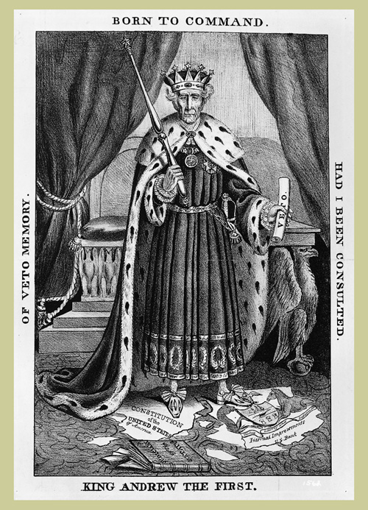
King Andrew

Slide 2
Targets

Slide 3
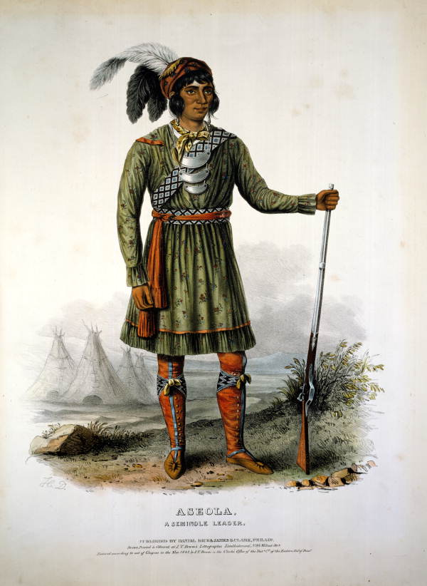
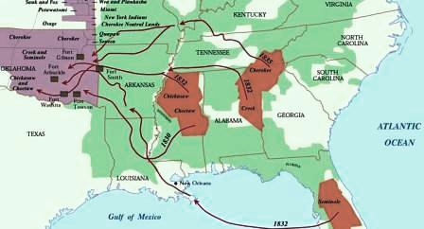
Minority Treatment
Little to no concern for AfAm or NAm
One of the largest slaveholders in SW; pro-slavery
Indian Removal Act (1830) – “voluntary” removal of NAms in Five Civilized Tribes→ Choctaw leave 1831
Seminoles resist most fiercely→ 2nd Seminole War
Trail of Tears (1830s) – Cherokee win Worcester v. Georgia→ Forced W. of Mississippi
Oceola

Slide 4
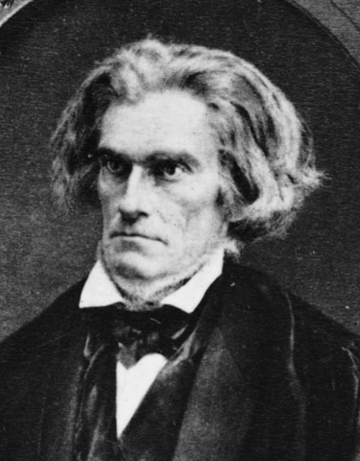

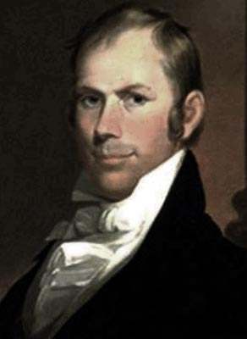
Nullification Crisis
1832 – S. Carolina feared protective tariff; claimed discriminatory & unconstitutional→
John C. Calhoun – changes political views to oppose Jackson & tariff (was VP)→
Stressed nullification of federal laws→
Jackson sends warships to protect union→
Henry Clay facilitates compromise tariff→OK!
Calhoun &
Sam the Eagle
Clay

Slide 5
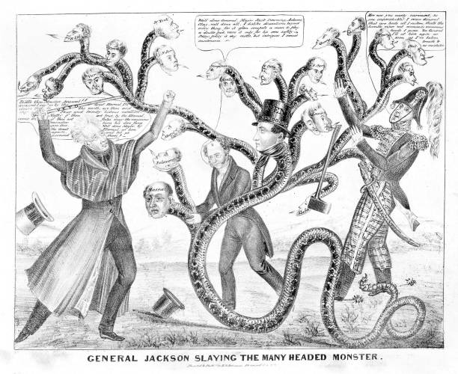
National Bank Controversy
2nd National Bank (1816-1836)
Jackson “almost obsessed” with destroying it; claimed unconstitutionality, but McCullough vs. Maryland (1819) said differently
Since Panic of 1819→ bank was prosperous; Jackson felt it a puppet to rich NE interests

Slide 6
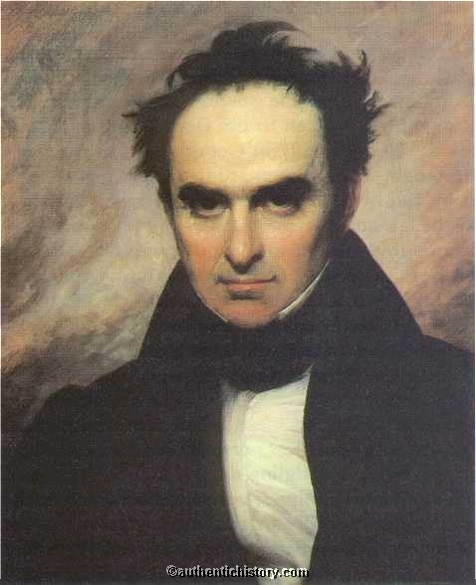
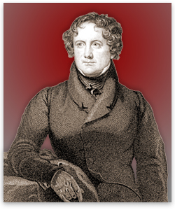
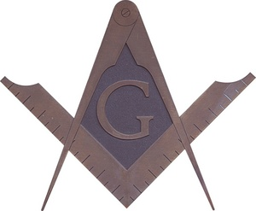
1823 – aristocratic Nicholas Biddle is pres of bank
1832 – Biddle—urged by Clay and Webster—pushed through renewal of charter early to make Jackson’s inevitable veto a campaign issue→ Wins re-election easily & veto stays as Anti-Masonic Party takes votes from Clay’s National Republicans
Jackson stopped using National Bank, instead opting for state “pet banks”
Biddle
Webster

Slide 7
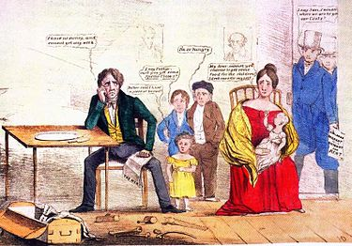
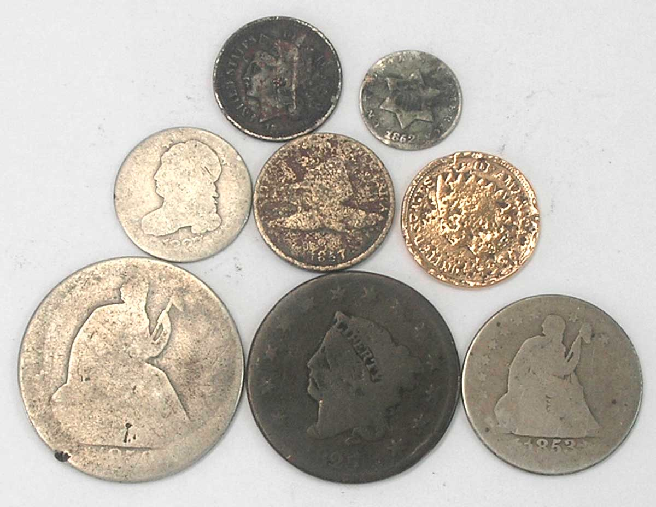
Panic of 1837
Biddle responds by calling in loans→ contracts fed. money supply→ pet banks speculate wildly
PANIC! – Federal surplus given to states + int’l payment deficit→ Federal bank is BROKE!→
Whigs – created as Anti-Jackson party in 1836
Specie circular – only gold and silver accepted as payment for federal lands→ hurts speculators

